Slide 1
The Fraternity Today

Slide 2
Nationals
The national head quarters is located in Charlotte NC
This is where Mid-Year Leadership Conference takes place
Mid-year is where all the new Executive officers for each chapter are trained
Happens every year over winter break

Slide 3
Different Conferences
Mid-year: every year at nationals to train new officers
Supreme Chapter: every even year to discuss legislative business, archon attends
Pi Kapp College: every odd year, educational/training conference

Slide 4
Entities of Pi Kappa Phi
The National Fraternity is split into 4 different areas each with its own board and money
The Fraternity
PUSH America
The Foundation
PKP Properties

Slide 5
National Council
CEO: Mark E. Timmes
J. Jeffry Wahlen – National President Mark F. Jacobs – National Vice President Dudley F. Woody – National Treasurer Tracy D. Maddux – National Secretary Thomas B. Sullivan – National Historian David M. White – National Chaplain Daniel J. Bosshart – National Chancellor

Slide 6
PUSH America
Journey of Hope: 70 Pi Kapps ride from San Francisco to D.C. in a summer
Gear up Florida: 25 Pi Kapps ride across the state of Florida
Give-a-PUSH and PUSH Camps: they are national service project weekends

Slide 7
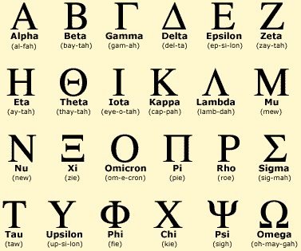
Alphabet

Slide 8
Creed
I Believe that the ideal chapter is made up of men
Who are bound together in a common loyalty which transcends any personal selfishness.
Who realize that membership means personal responsibility in bearing their share of the financial burden of the chapter and the national organization.
Who bring credit to the fraternity by striving to attain the highest possible standards of scholarship.
Who safeguard the reputation of their chapter by keeping careful watch over their personal conduct.
Who uphold faithfully the traditions and activities of their college.
Who prepare themselves diligently to shoulder their full responsibility as citizens.
I Believe that my chapter can become an ideal chapter, and I shall do my share to make it so.

Slide 9
Diamond

Slide 10
Alumni Initiation

Slide 11
Standards Board

Slide 12
No Quiz Next Week
Please make sure you have 15 brothers interviewed by next class
Also make sure to finish up Greeklife.edu by initation
Sit down with your big and do the national exam!

